Slide 1
GoodTrade software manual

Slide 2
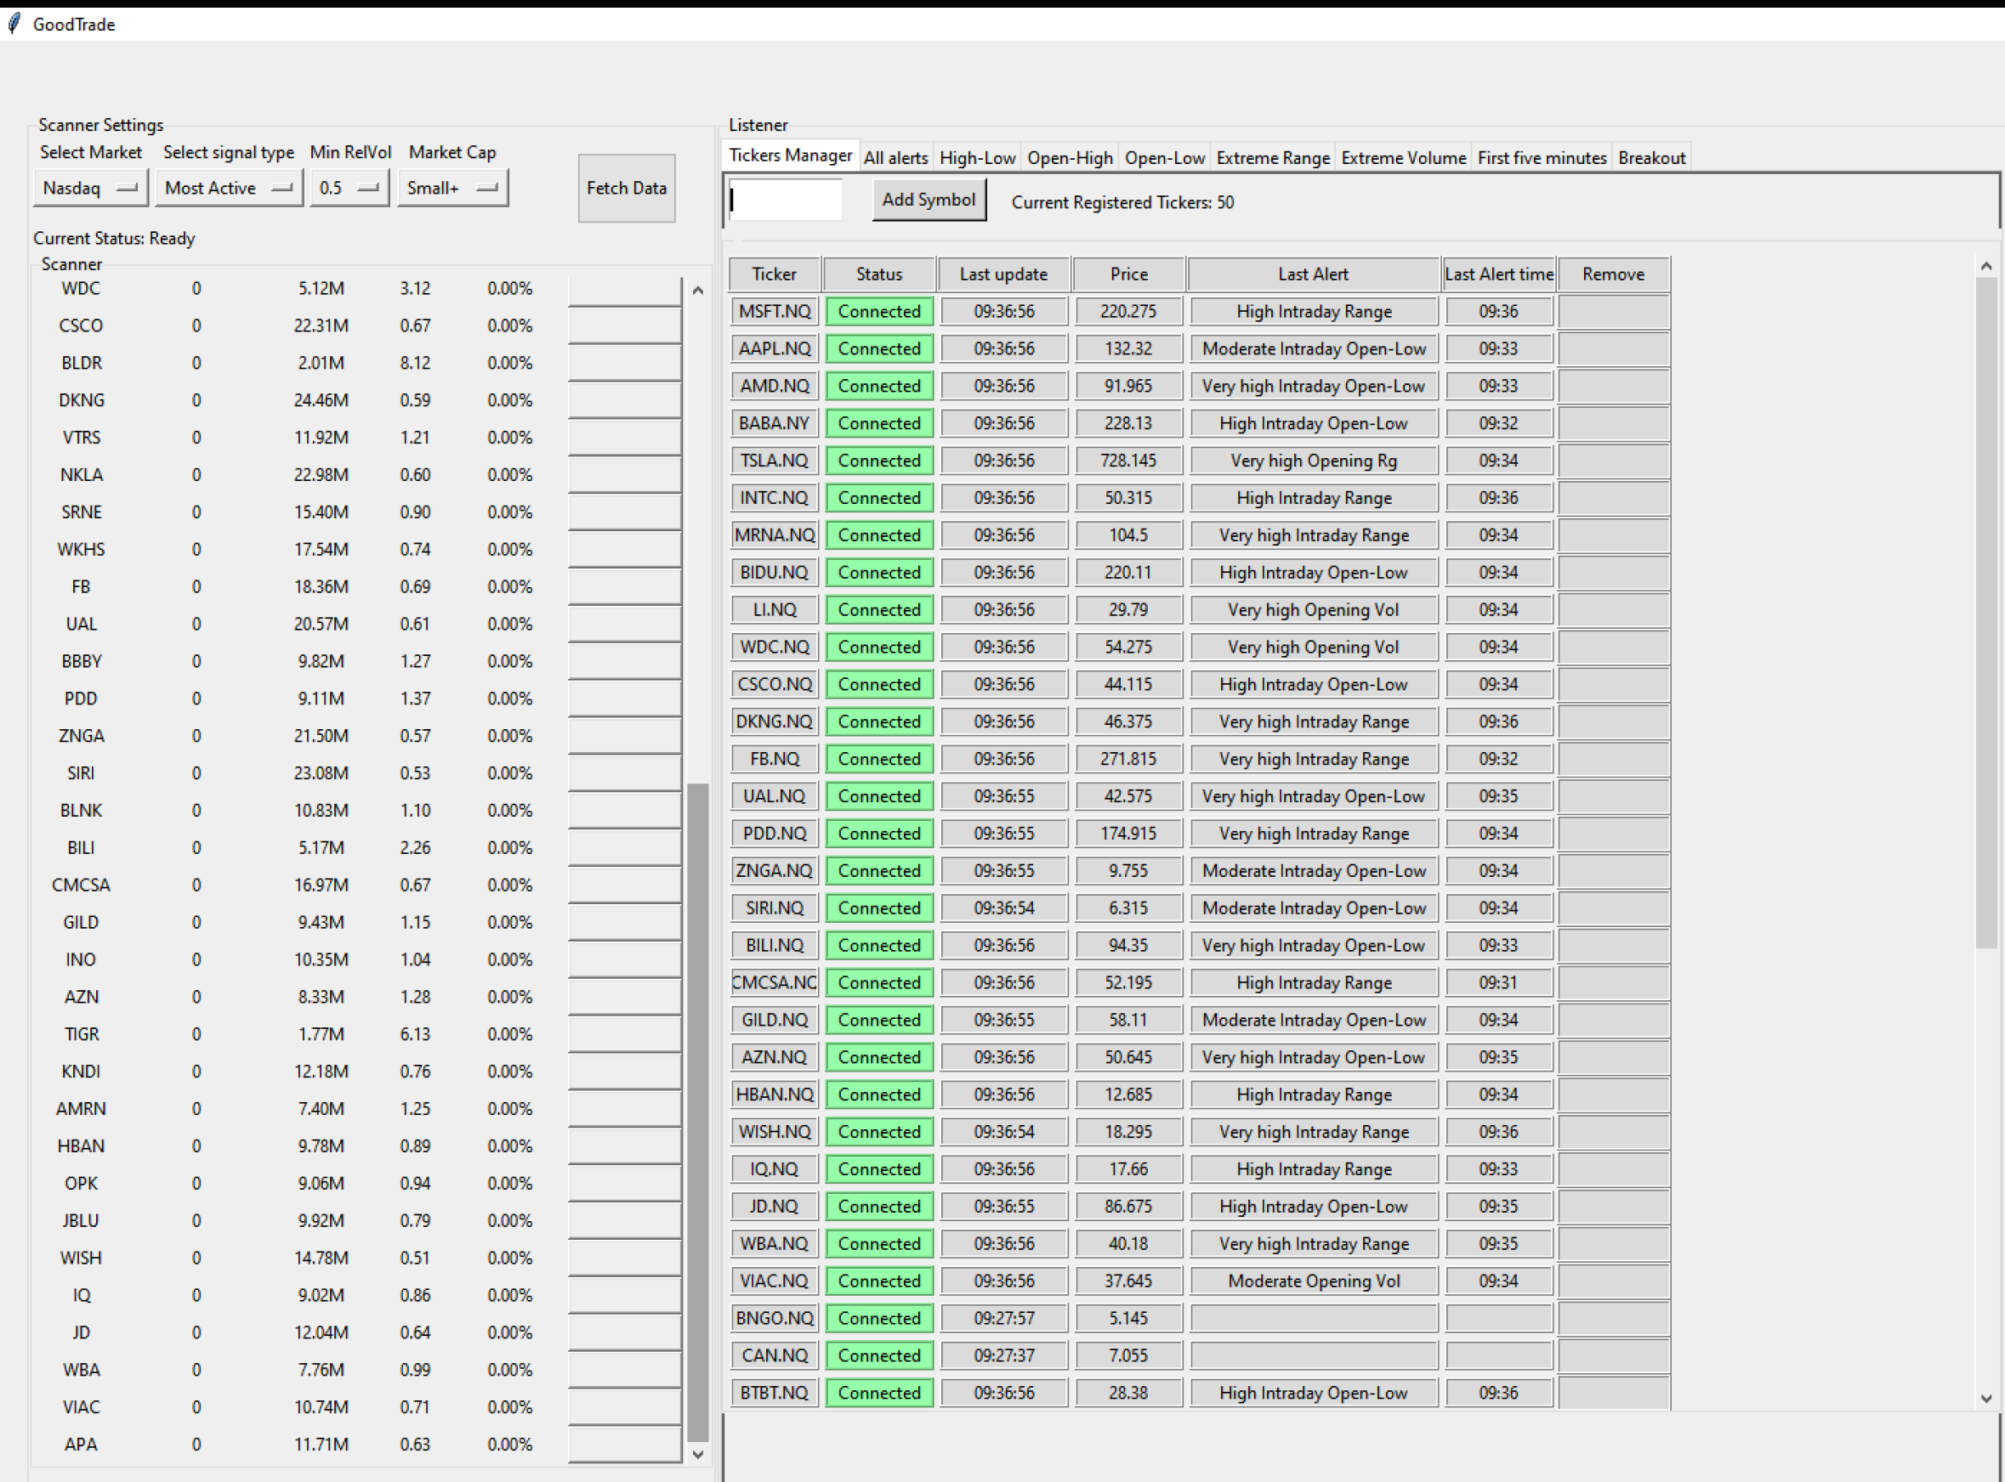
Overview
GoodTrade has two main components: Scanner and Alerts system.
Scanner filters out live stocks based on certain conditions such as relative volume, most active, etc.
Alerts system is able to receive notification when a certain condition is met.
Symbols showed in Scanner can be added to Alerts system directly and subscribe to all alerts.
Running requirements:
1. Python3.8 or above installed
win32: https://www.python.org/ftp/python/3.8.7/python-3.8.7.exe
win64: https://www.python.org/ftp/python/3.8.7/python-3.8.7-amd64.exe
2. Git
win32:https://github.com/git-for-windows/git/releases/download/v2.30.0.windows.2/Git-2.30.0.2-32-bit.exe
win64: https://github.com/git-for-windows/git/releases/download/v2.30.0.windows.2/Git-2.30.0.2-64-bit.exe
Note : To enable the alert system working, user must be logging onto Ppro TMS for the moment. Future updates will levitate this requirement.

Slide 3
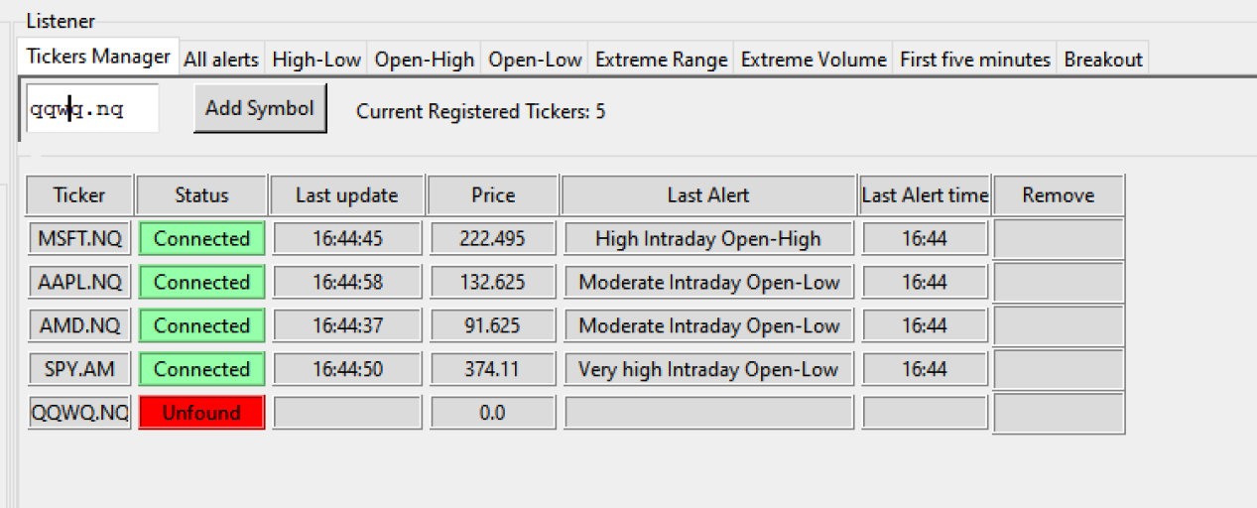
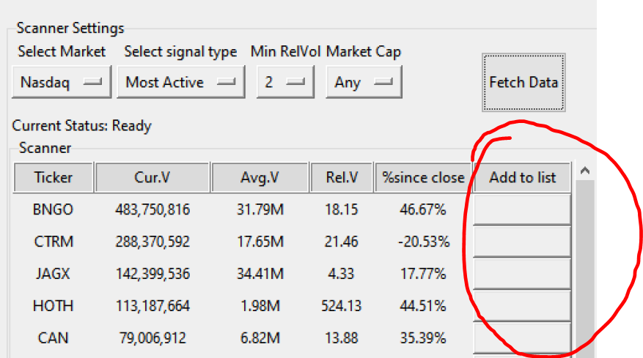
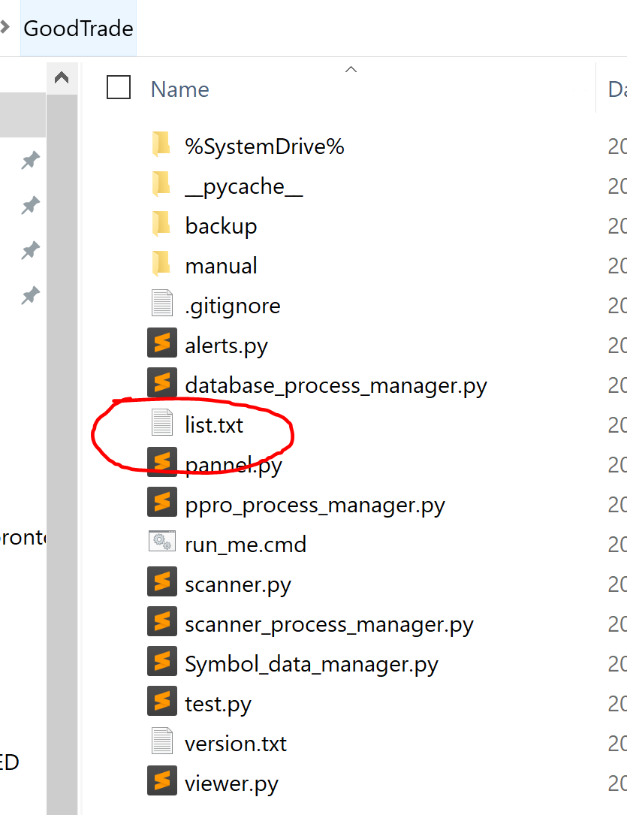
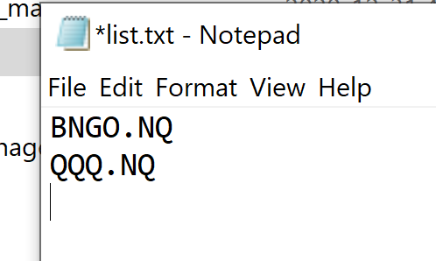
Alert system – managing symbols
There are two ways to add symbols to the alert system; 1. input it directly from the Tickers Manager. 2. Add it from Scanner.
To remove a symbol from the alerts listener, simply click remove in the Tickers Manager.
When a symbol is added to the listener, it is automatically subscribed to all alerts.
Bulk Management
To edit many symbols more efficiently, user is able to open list.txt and add, or delete symbols.
Note : User should perform this operation before opening the application. Any changes of list.txt during application running will not be saved correctly.

Slide 4
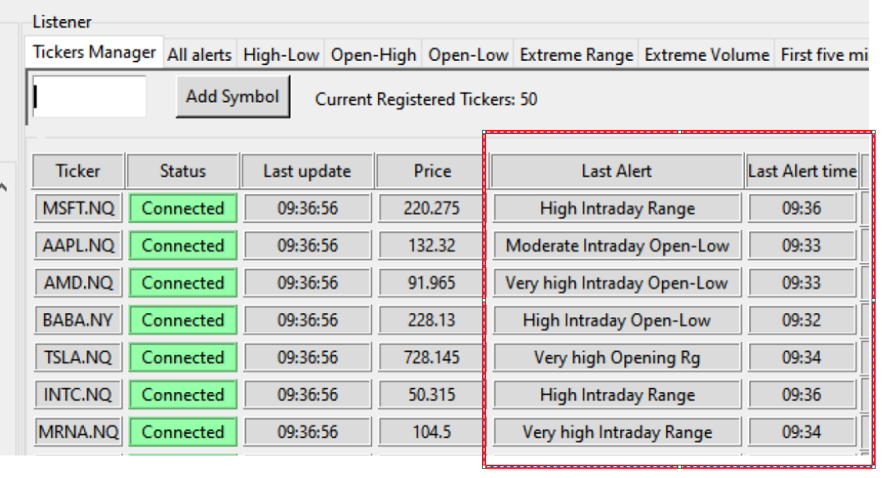
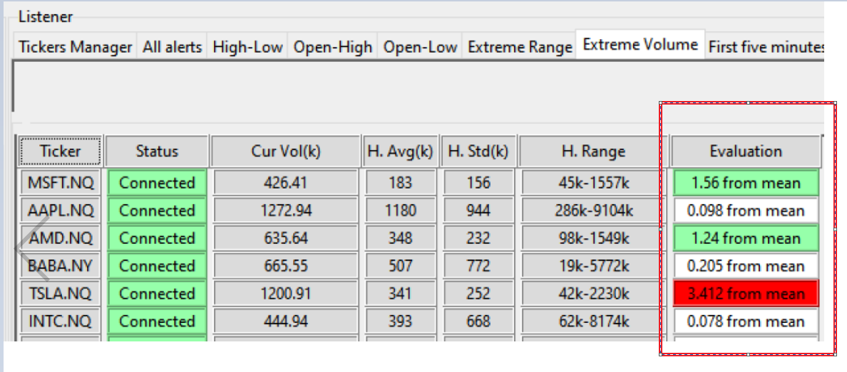
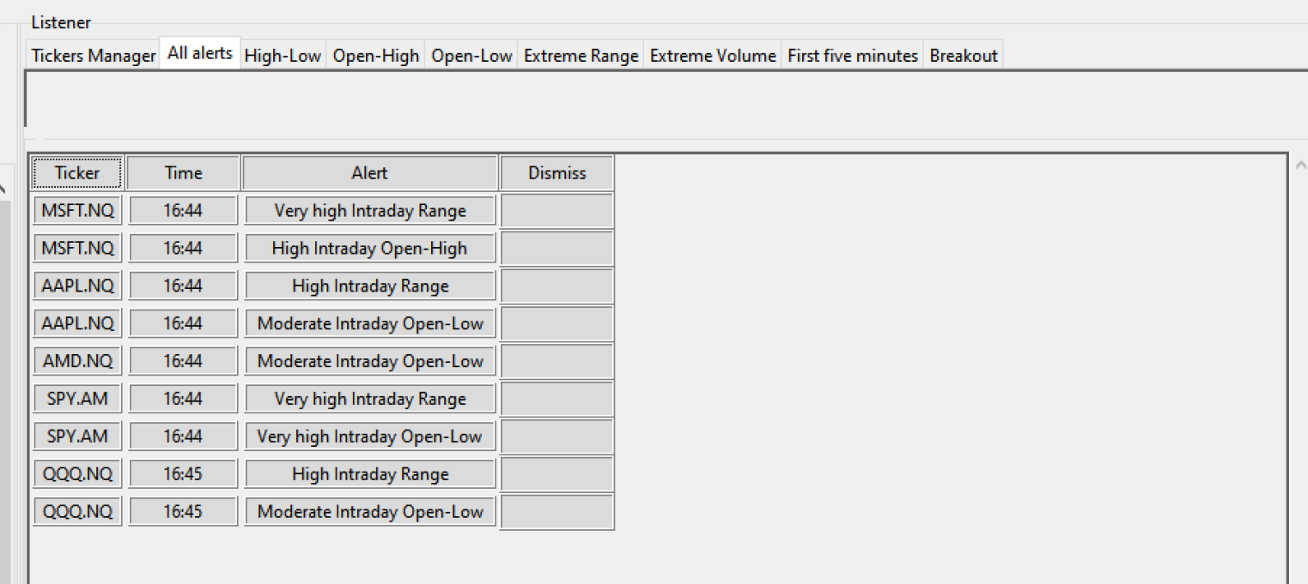
Alert system – Receiving alert.
The user will receive an alert in three ways:
Most recent alert via Tickers manager. Last Alert: the type of alert. Last Alert time: The time the alert was produced.
2. Evaluation in alert-condition panel( Extreme Range, etc.)
1.56 from mean meaning current value is 1.56 standard deviation above the mean.
tint indicates the extent of the condition: red: very high (2 std and more) , yellow: high(1-2 std range), green: worth noting(0.5-1) , and white: normal(mean within 0.5 std)
3. All alerts panel displayed each alert received.

Slide 5
Alert system – alerts type
The alert system supports conditions:
High-Low:
Evaluate a stock based on its current day range and 10 days historical range.
Open-High;
Evaluate a stock based on its current day open-high and 10 days historical open-high range.
Open-Low:
Evaluate a stock based on its current day open-low and 10 days open-low historical range.
Extreme Range:
Evaluate a stock based on its last 5 minutes range and historical average 5 minutes range.
Extreme Volume:
Evaluate a stock based on its last 5 minutes volume and historical average 5 minutes volume.
First five minute:
Evaluate a stock based on its opening range and volume to its10 days opening average.
Breakout :
Receive notification when price breaks given support/resistance level.

Slide 6
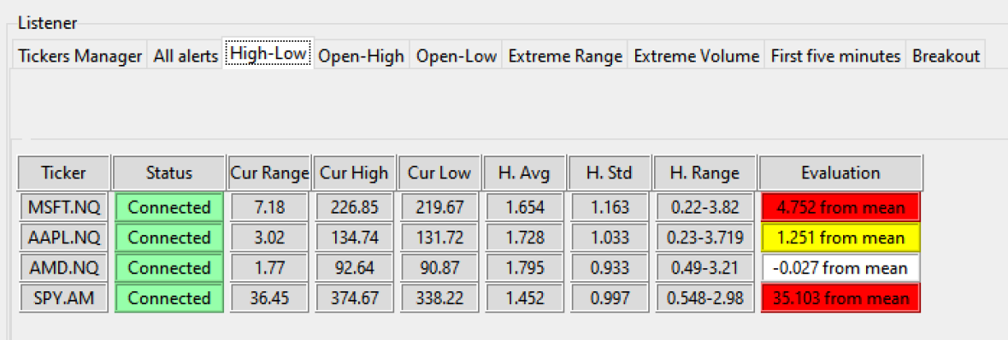
Alert system – high low
Cur Range: Current day high-low range.
Cur High: Current day high
Cur Low: Current day low
H.Avg: Historical 10 days Average daily range
H.Std. Historical 10 days daily range standard deviation
H.Range. Historical range of daily

Slide 7
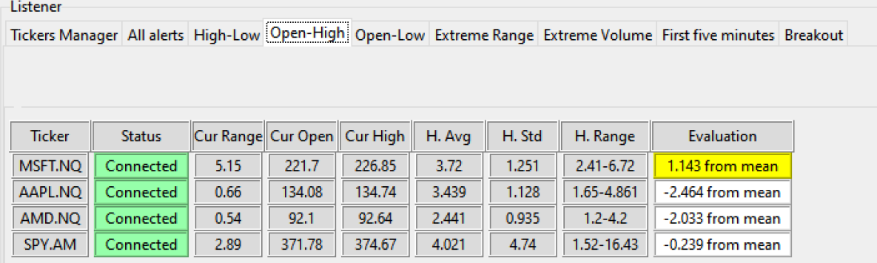
Alert system – open high/ Open Low
Cur Range: Current day open-high range.
Cur High: Current day high
Cur Open: Current day open
H.Avg: Historical Average daily range of Open-High
H.Std. Historical daily Open-High standard deviation
H.Range. Historical range of daily Open-High

Slide 8
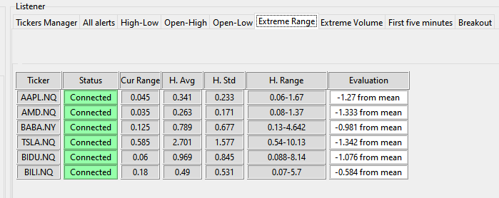
Alert system – Extreme range
Cur Range: Current last 5 minutes range
H. Avg: Historical 5 minutes average
H. Std: Historical 5 minutes range standard deviation
H. Range: range on Historical 5 minutes range

Slide 9
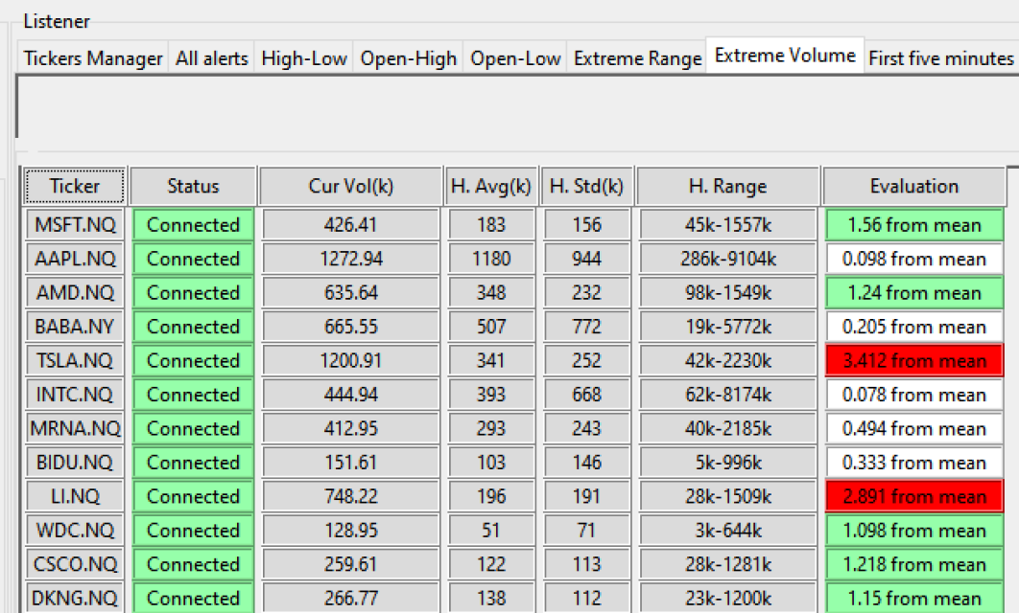
Alert system – Extreme volume
Cur Vol: Current last 5 minutes volume. (unit is thousand)
H.Avg: Historical 5 minutes average volume
H.Std: Historical 5 minutes volume standard deviation
H.Range: range on Historical 5 minutes range

Slide 10
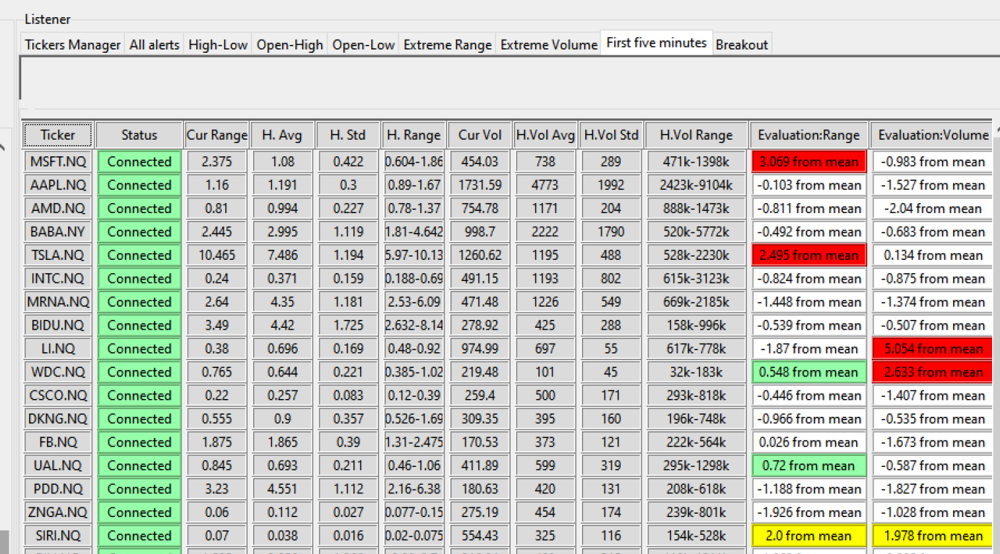
Alert system – First five minutes (opening 9:30-9:35)
Cur Range/ Cur vol: opening 5 minutes range /vol
H.Avg: Past 10 days average opening 5 minutes range/vol
H.Std: Past 10 days opening 5 minutes range/vol standard deviation
H.Range Past 10 days range on opening 5 minutes range/vol

Slide 11
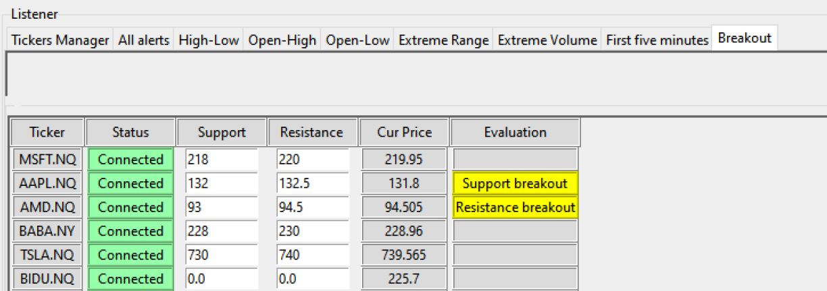
Alert system – breakout
Current stage require manually input support/resistance level.
Upon breaching the level, an alert is generated.
Future version auto support-resistance recognition will be added.

